Slide 1
Advance Database Project Management
Insights into Factors Leading to Road Traffic Accidents in the United Kingdom
Presented
By
Tharindu Niroshan Madushanka Deegoda Kankanamge

Slide 2
Business Case
Road transport is an important infrastructure that contributes to the social and economic development of a country. Due to the large population, people now rely on accessible and good roads to enable easy commute to access education, jobs, and health centers(Boarnet, 1999). Over the years, road transport in the United Kingdom has been the most heavily used means of transportation (Hall et al., 2020); individuals in the UK travel more than 440 billion miles by road. On average, people in England made 739 trips across private and public modes. However, every year in developing countries, an estimated 1.2 million people are killed in road traffic accidents and 50 millions injured.
Road traffic accident(RTA) constitute a significant portion of the global health related problems and it is also a leading cause of death by injury, this calls for road safety measures; the need for safety measures comes a long way in reducing the risk of accident casualties, as this can place a strain on the national health system(Gopalakrishnan, 2012).
It is on this note that UK goverement has approached the team to gain insight into road accident problems, the causes of accidents and recommendations on the procedures and interventions that must be implemented by the government to reduce the risk of traffic accidents.
Key search Terms
Road traffic accident
UK road accident
Road safety

Slide 3
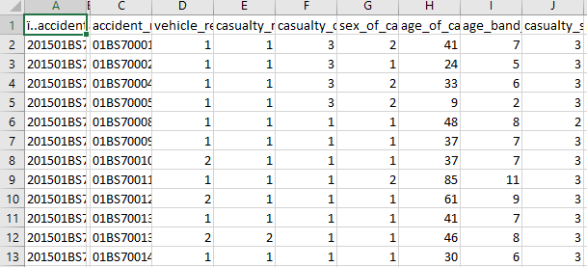
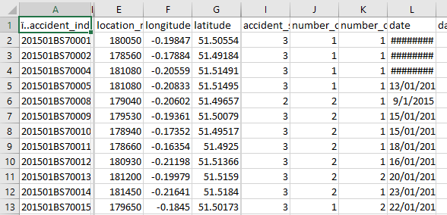
Definition of Dataset / Source of dataset : 2015 – 2019 worth of data
Accident dataset: These include details of the road accidents recorded e.g., the road type, speed limit; junction details; number of accidents and vehicles involved in the accident; severity of the accident; date, time and location of the accident..
Casualty dataset: This includes the victim's age, gender, and level of injury (fatal, serious, or minor); and the victim's casualty class, which is whether they were the driver, passenger of the vehicle or a pedestrian.
Source: https://roadtraffic.dft.gov.uk/custom-downloads/road-accidents/reports/93e0efc1-6337-44db-ae68-a226eb1c96c0
Source: https://data.gov.uk/dataset/cb7ae6f0-4be6-4935-9277-47e5ce24a11f/road-safety-data

Slide 4
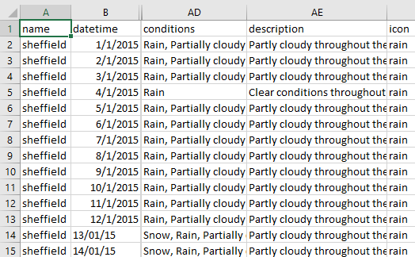
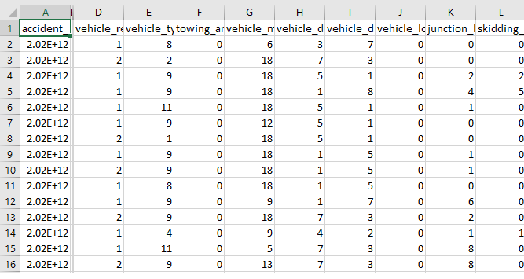
Definition of Dataset / Source of dataset
Weather dataset: Involves the common weather measures such as rainfall, windspeed, snow and weather conditions. It contains 2015 to 2019 daily weather record for each cities and town in the UK
Vehicle dataset: Each vehicle involved in the accident must fill out a separate form with information about it, its movements prior to and during the collision, some characteristics about the driver (age, sex, destination, and home postcode)
https://weather.visualcrossing.com/VisualCrossingWebServices/rest/services/timeline/south%20Yorkshire/2015-01-01/2017-05-31?unitGroup=metric&include=days&key=WK6LC5WXP2L37SWR96EQ9JVKS&contentType=csv
Source: https://data.gov.uk/dataset/cb7ae6f0-4be6-4935-9277-47e5ce24a11f/road-safety-data

Slide 5
Justification for Chosen Dataset
Addressing the problem of RTAs requires careful insight into some major causes which can be classified into human factor, vehicle factor and environmental factor.
To gain insight into these factors which can impact road traffic accident rates in the Great Britain we decided to acquire the following datasets to build our data mart.
Weather Dataset- several studies have identified weather to be a major factor in the cause of RTA. according to Johnson et al.,(1999) weather is a well know player in RTA because it can create slippery roads which contributes to crashes. Hence, we wish to gain insight into which weather caused the most RTAs and recommend solutions on safetly measures.
Accident Dataset: The goal of accident dataset is to identify potential factors—such as date, accident severity, accident location, road type, junction details, speed limit etc. that are contributors to RTA. Unfamiliarity with roadway, inattention to junction location can lead to crashes(lester et al., 2010)
Casualties Dataset: The purpose of Casualty dataset is to gain insight into the age, severity and the class of injured persons in an accident across Great Britain. a study by Asolor(2008) showed that a significant number of RTAs are linked to road users
Vehicle Dataset: Our quest for vehicle dataset is to assess the age and sex of drivers that causes the most accident, type of vehicles involved in theses accidents. According to Ovuwori et al.,(2010) the vehicle is a component of road traffic system and the age, type, tires, engines are among the vehicle subsystems that can cause RTAs

Slide 6
Business Questions and Justification
1. Provide a breakdown of RTA by road type, junction details, vehicle type, by accident severity, by number of casualties by month, by days of accident, and time of accident for the UK from 2015 to 2019
To access the number of accidents that happened on different road and junctions, the type of vehicles that are mostly involve in RTA accidents, the severity of the accident; if it was a minor accident or if the accident resulted in death, to also access the number of accidents that happens each month, each day of the week and the time of the day (in hour) Only RTA from 2015 – 2019 will be analyzed to provide recommendation.
2. Provide a breakdown of RTA by weather type, by accident severity, by number of casualties for the UK by month and days of accident from 2015 to 2019.
Weather is known to be a major factor leading to road accidents; hence we want to identify the number of accidents during different weather condition in different location in the UK and the severity of these accidents for each month from 2015 -2019. This will help us recommend to the UK Highway Road Authority to provide relevant road safety precautions to road users during these weather conditions
3. Provide a breakdown of RTA in the UK by the total number of accidents, per age and sex of drivers per fatality from 2015-2019
A study by Asolor(2008) showed that a significant number of RTAs are linked to road users. hence, we want to gain insight into the age and gender of drivers involved in RTAs that led to death in the UK. This will help us recommend to the county regrading drivers
4. which day of the week recorded the greatest number of accidents in the UK by age of casualty and class of casualty from 2015-2019
To find out the class of individuals affected in these accidents; if it was the drivers, passengers or pedestrians and their age. This will help to bring awareness to these class of individuals on Road safety measures
5.Give a breakdown of RTA by total casualties in the UK by light condition, and road surface condition for each month from 2015- 2019.
Slippery roads and bad lighting can contribute to road crashes; hence we want to find out how different light condition and road surface condition affect RTA in the UK and which of these bad road or bad lighting recoded the most accidents that led to death. This will help us recommend to the department of transport on road maintenance

Slide 7
Key Features
Attributes | Description
Accident severity | To measure the impact of the incident, if it was a minor, serious or fatal accident
Accident Location | The region, county, cities and town in the UK where these accidents happen
Road_type | What type of road where most accidents occur
Junction detail | To access the particular junction location where these accidents occur
Accident Date | This specifies the year, month and days of the week accidents occur in the UK
Road surface condition | To ascertain the road surface condition that led to the accident
Casualty severity | To determine the severity of the injury or if the accident led to death
Casualty class | To ascertain the type of people who died or injured from the accident
Time | This specifies the exert time of the day accidents happen
Age of casualty | Age of the individuals injured or died from the accident
Weather type | To know how different weather condition causes RTAs in the UK
Vehicle_type | To determine the type of vehicle that cause the most accidents
Sex of driver | The sex of drivers that cause the accidents
Age of driver | To assess the age of drivers that cause the road traffic accidents

Slide 8
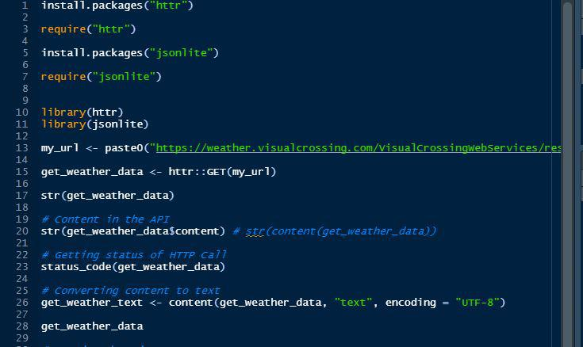
Data Gathering Technique
Following the identification of business questions. websites like visual crossing, UK government, and Office for National Statistics (ONS) were surveyed.
There were two approaches to gathering data, one was to download the datasets that were already available via comma-separated values (CSV) and the other to stream the data from the websites with the help of an API service provided by the website owner. A hybrid approach was followed: comma-separated values (CSV) datasets for accident, casualties and vehicle was downloaded and API was used to extract the weather dataset.
Weather dataset was extracted using API in R Studio

Slide 9
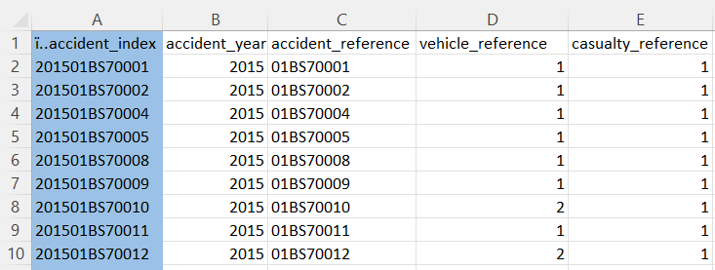

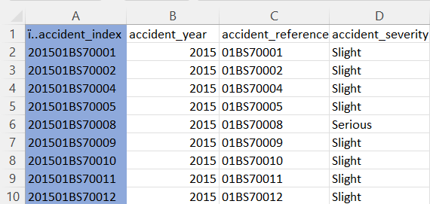
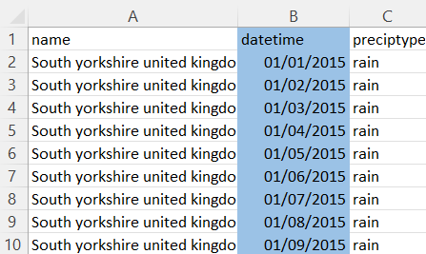

Joining the Dataset
Accidents, Casualty, and vehicle data sets are joined by using accident index since accident index is unique key for these three data sets.
Weather data set was merged by using date and location since these column is common for both data set.
Figure – Weather Dataset

Slide 10
Software Solution
Hadoop Distribution Vendor: This project uses Microsoft Azure to defect the compatibility issues faced by other Hadoop platform. It is fully powered by Hadoop and can easily integrate with Tableau for the visualization.(Sarkar, 2014). R Studio: R was used for data cleaning and integrity check because of its strength in identifying and removing inaccurate raw data; however, due to its limitation in handling large volume of dataset, we will utilize SparkR within RStudio to interact with Apache Spark using an R package called dplyr to manipulate the data. (Oussous et al., 2018) | Apache Hadoop: Hadoop framework was utilized for this project because of its flexibility in storing and processing big data due to its large storage capacity and high processing power which saves time when compared to other traditional relational database management system (RDBMS) provides mature fault tolerance (Jonnalagadda,2016). Hadoop Distributed File System: Because of its reliable storage capability, HDFS was utilized for the development process, the data will be stored on HDFS which is the primary storage for Hadoop. (Hadoop: The Definitive Guide - Tom White - Google Books, n.d.).
Apache Hive: Hive was adopted because it uses batch processing to analyze data quickly across large database compared to traditional RDBMS that are designed to query small dataset. Also, it is built on Hadoop framework which simplifies the integration process. This project will use HiveQL to execute queries, access data and build the data marts | Tableau: Its great graphical and pictorial representation in visualizing the data effectively due to its simple drag-drop when compared to other visualization tools; also because of its compatibility, it simplifies Hadoop technology by means of easy connection to Apache Hadoop to transform data stored in the data mart and analyze data into an interactive visualization (Cota et al., 2014).

Slide 11
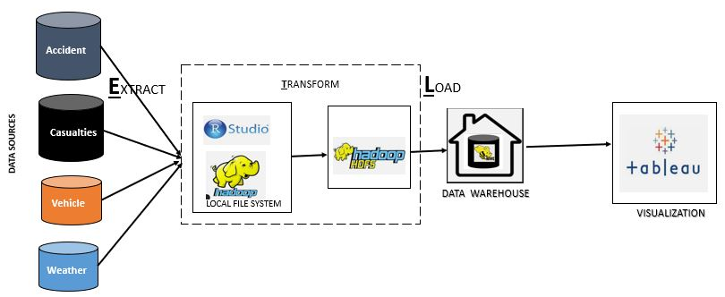
Development Methodology
It requires a little period to complete considering the timeline allocated for this project as it focuses on locating the ideal response for a certain area.
Data retrieval is quick since the data amount is not excessive.
With the addition of new data marts and the expansion of current data marts, scaling up is inexpensive and simple.
This project will adopt the Kimball methodology which follows the bottom-up approach.
Why are we using Kimball’s Approach
The design of the DataMart is formed based on the 5-business question, hence only data required to answer the business
requirement is accounted for.

Slide 12


Data extraction
Accident, vehicle and casualty's dataset
Weather dataset
Downloaded via API in R
Stored to Google drive
Accident.csv
vehicle.csv
casualty.csv
Converted to text file
Gov.uk
ONS
Downloaded to Hadoop local file system
stored to Hadoop local file system

Slide 13
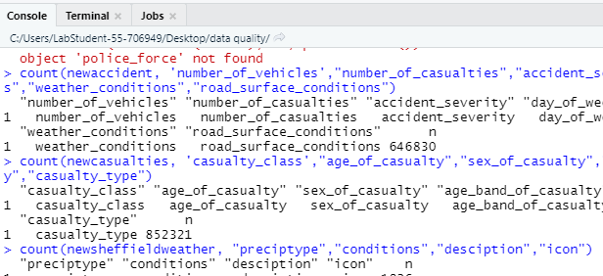
Raw Dataset Validation
Data Preparation
Data Quality Check – frequency count for variables
DATASETS | VARIABLES | OBSERVATION | MISSING VALUES
ACCIDENT | 36 | 646830 | 1,770
CASUALTY | 18 | 852321 | 29,293
VEHICLES | 27 | 1,192,060 | 163,102
WEATHER | 33 | 531,564 | No missing value
Accident data = 646830
Casualty data = 852321
Vehicle data= 1.192,060
Weather data = 531,564

Slide 14
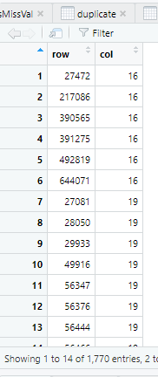
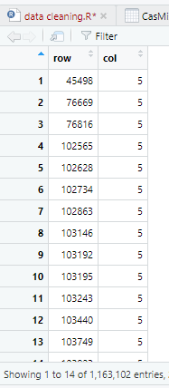
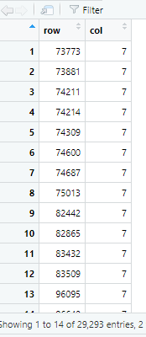
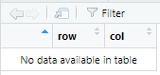
Data Quality Check Incomplete Error : missing record
Missing values for Accident dataset = 1,770
Missing values for casualty dataset = 29,293
Missing values for vehicles dataset = 163,102
Missing values for weather dataset = no missing value
weather dataset
accident dataset
Casualty dataset
Vehicle dataset

Slide 15
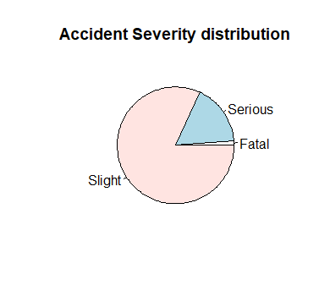
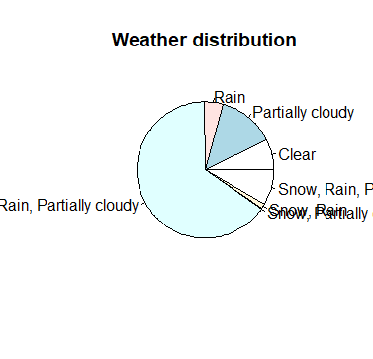
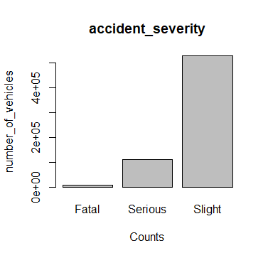
Data Quality Check
Checking values of character variables using horizontal bar plot and pie chart for missing values
We assigned name NA to missing values for the character variables, but no missing values recorded

Slide 16
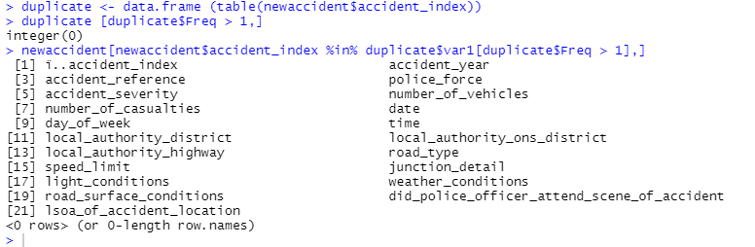
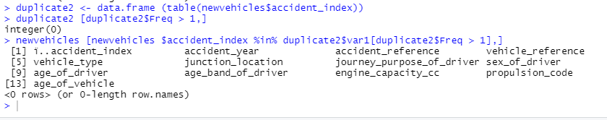
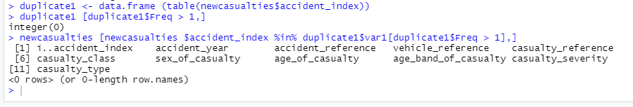
Data Quality Check Incorrect Error : duplicates, wrong information
Accident data
We observed some duplicated values like dates, accident severity, time age of drivers in some of columns, however it does not affect the integrity of the data
vehicle data
casualty data

Slide 17
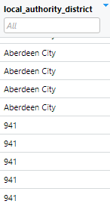
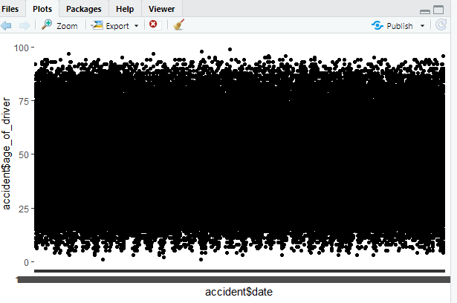
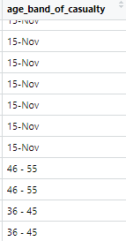
Data Quality Check
Out of range data-outliers:
Accident data
Casualty data
Weather data
DATE Column
We checked the weather dataset for any outlier in the data column
We observed some out-of-range values in the location column of the accident data and the age band column of the casualty dataset.

Slide 18
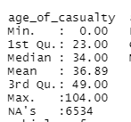
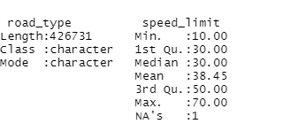
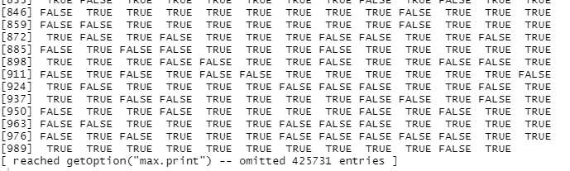
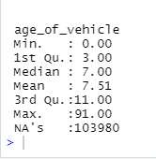
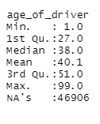
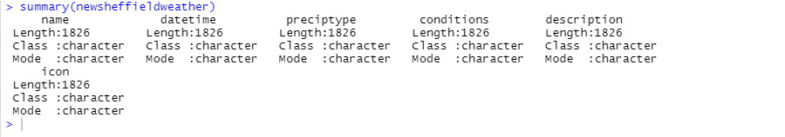
Data Quality Check
Inconsistent: empty values, nulls
The false represent null values
However, it doesn’t tell which column they are. So we use the summary function to identify the columns
casualty dataset
Accident dataset
vehicle dataset
Weather dataset

Slide 19
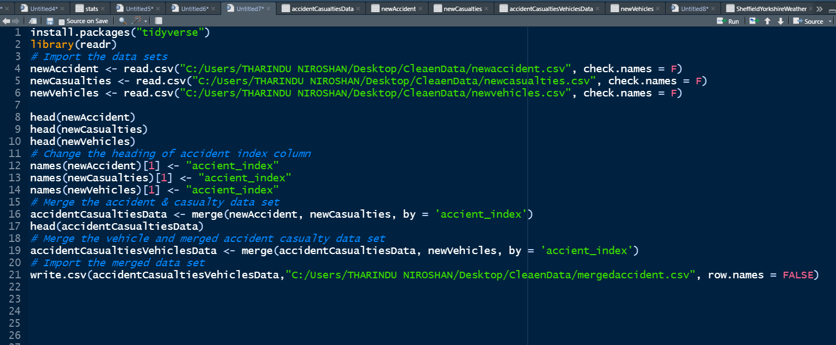
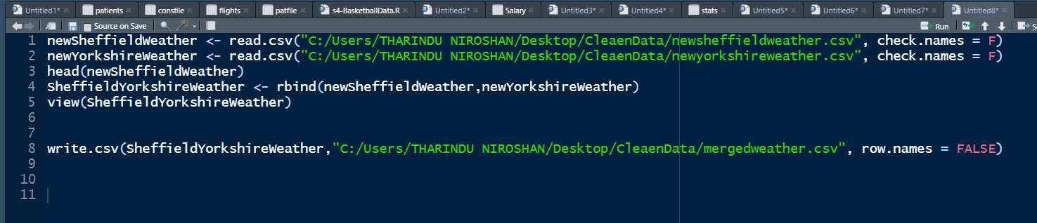
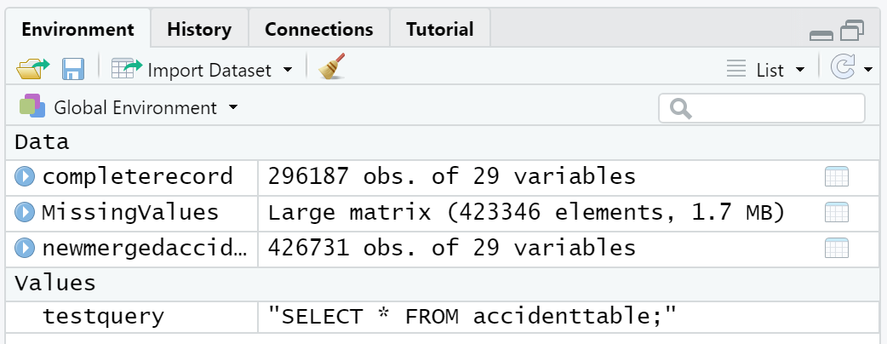
Data Transformation - Cleaning
We merged the accident, vehicle and casualty dataset using the accident index which is the unique key for joining all three data THEN we merged to the weather dataset using the date and location column.
After merging all datasets, we had 426,731 observation because it only select accident information that are contained in all four dataset
MERGING ALL DATASET

Slide 20


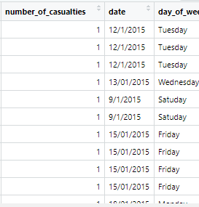
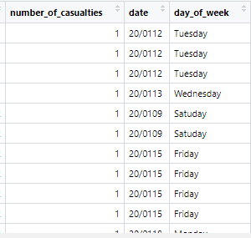
Data Transformation - Cleaning
Working with date column
Convert date field to correct datatype
Wrong date format
Firstly, we checked the datatype for date column then we check the date column to be sure all field are in the correct format However some rows had a wrong date format
We transformed the data column into the correct United Kingdom date format

Slide 21
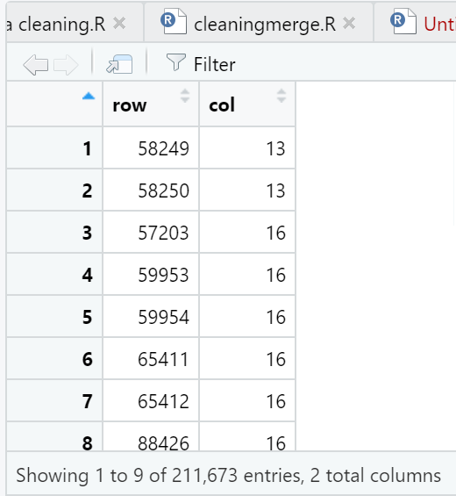
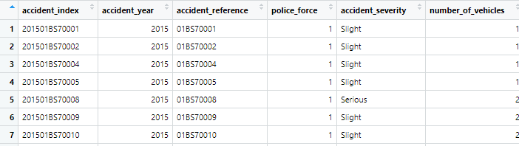
Data Transformation - Cleaning
Dropped some columns
Renamed some columns
Assigning zeros to NULL values
Identifying NULL values with completed case function
Assigning readable columns name
We had 211,673 null values present in the dataset; most were from unwanted columns that are not needed for the business question. However, we assigned zeros to null values to avoid losing important data

Slide 22
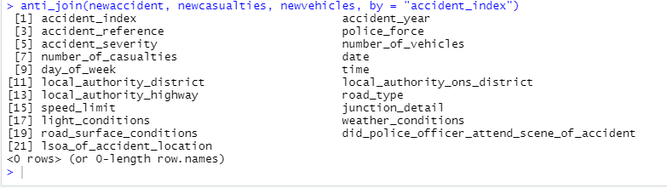

Data Integrity Check
Transformed / Cleaned Data Validation
DATASETS | VARIABLES | OBSERVATION | MISSING VALUES
Merged dataset | 29 | 426,731 | 211,673
After assigning zeros to null values | 29 | 426,731 | 0
TO preform integrity check, we checked if every value of the date and accident index in the accident dataset also appear in the casualties, weather and vehicle dataset.
We used the anti-join function
Files saved as AccidentTable

Slide 23
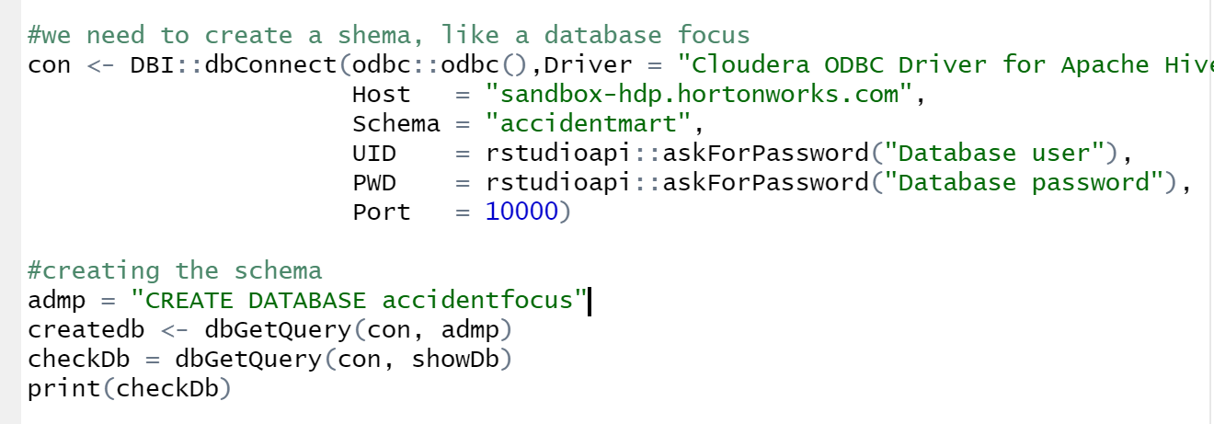
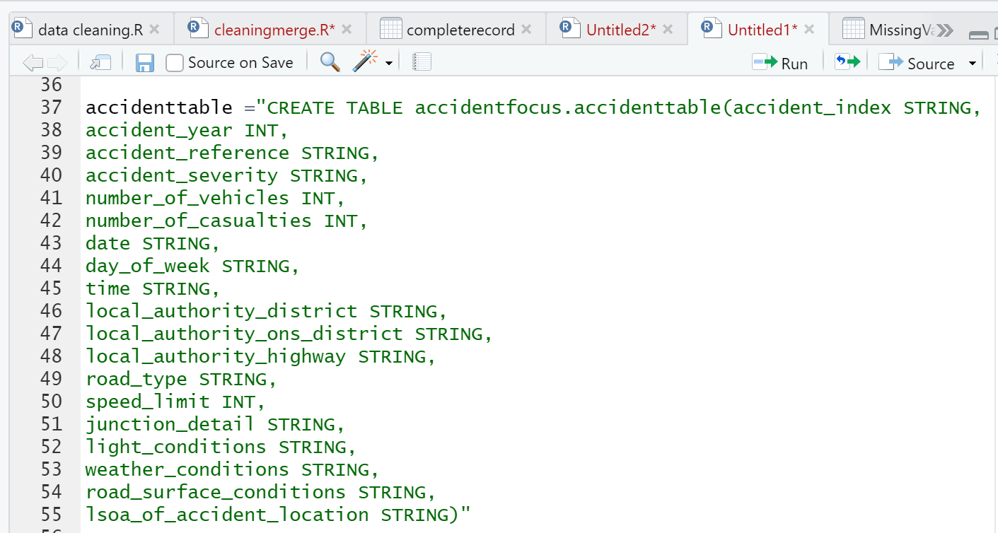
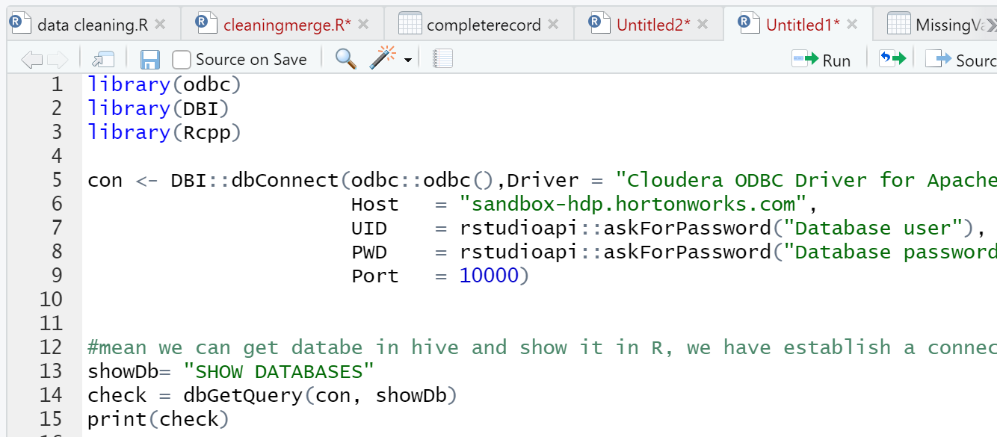
Data Automation using BDDI Tools
Data pipeline flow
Database in Hive
Connect R to hive using ODBC and DBI package
Created a database in hive from Rstudio
Created Table and table Headers into the database from Rstudio
Append the transformed data into created table
Table headers in Hive
Connected R to Hive

Slide 24
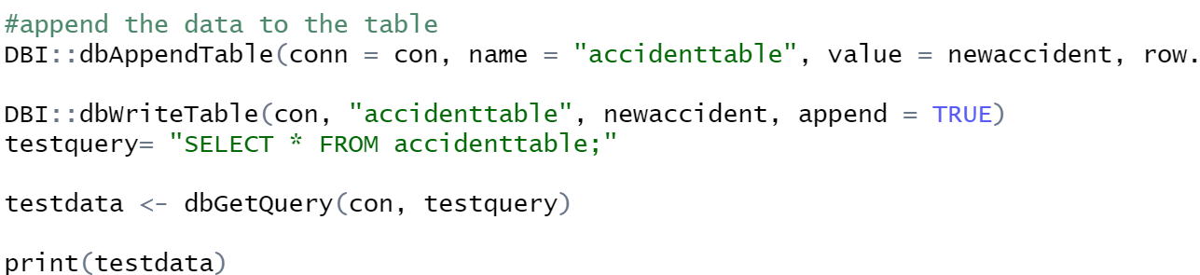
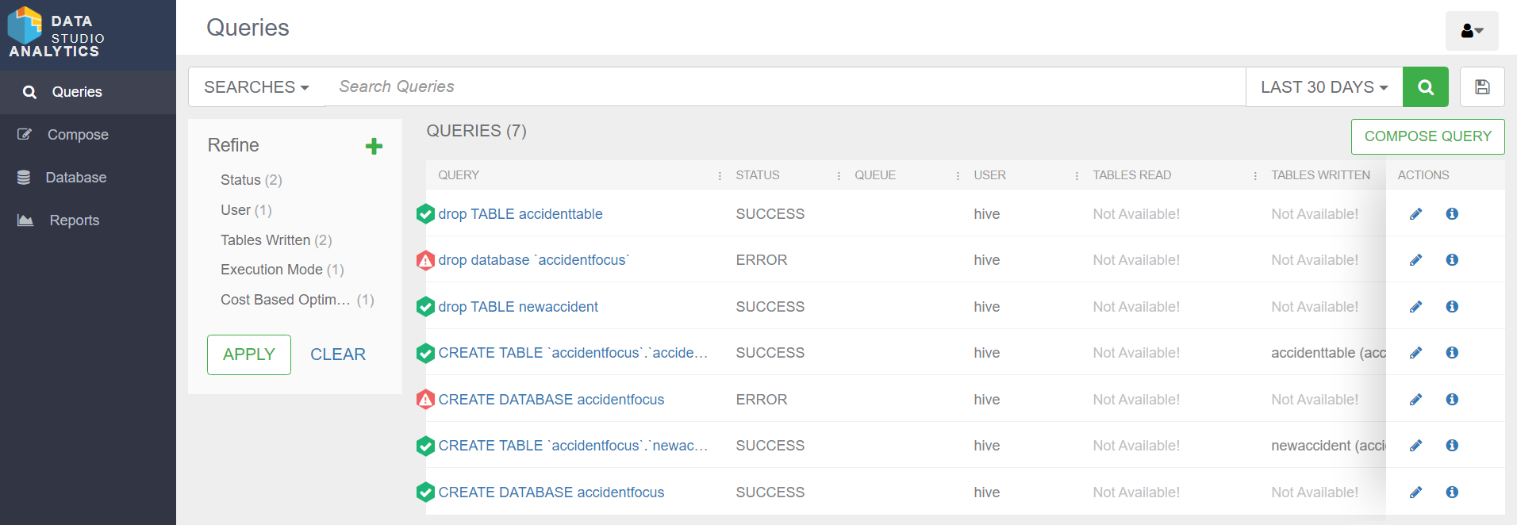
Data Automation using BDDI Tools
Data pipeline flow
Append data into table
Append the transformed data into created table
Evidence of database and table in hive
Database and table in hive
Evidence of created database and table in Hive

Slide 25
Data Automation using BDDI Tools
Alternative Data pipeline flow
Challenges faced
We were only able to append 3,000 observation from R into the created table in hive automatically because a warning message prompted that we have exceeded the allocated memory space in azure visual machine
Alternative automated data pipeline flow
Connect R to hive using ODBC and DBI package
Created a database in hive from Rstudio
Created Table and table Headers into the database from Rstudio
Loaded the transformed dataset from Hadoop local file system to HDFS
Loaded the data from HDFS to Hive Table

Slide 26
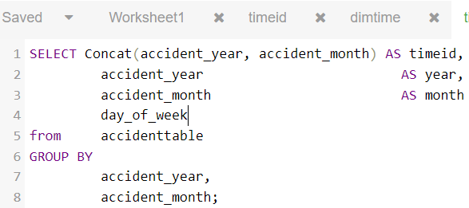
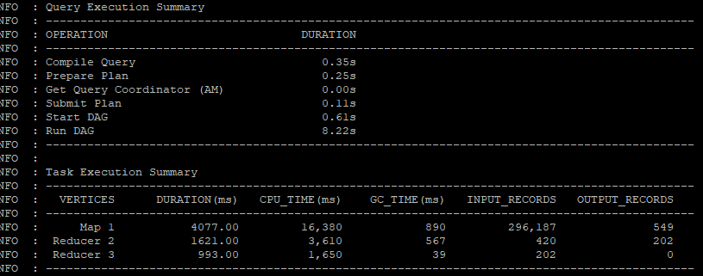
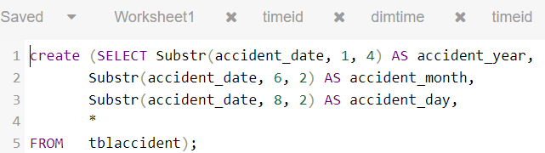
Steps in Creating Dimension and Fact Tables
Creating dimensions and fact tables in hive was slow, hence, Putty was used because it was faster.
Time dimension: to create the time dimension table we split the year, month and day from the date column and concatenated the year and month to form the time ID column
Creating the timeID using the concatenation function in hive
The dimension tables contains only one occurrence of the values and it’s unique ID which was achieved using the “group by” function
primary key was created for each dimension table using “row() over()” function
Fact tables contains all occurrences of values, the primary keys from the dimension tables(composite keys in the fct tables) and the business measures

Slide 27
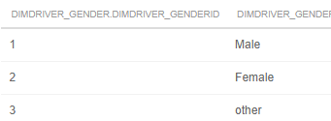
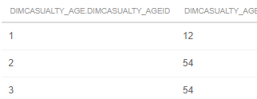
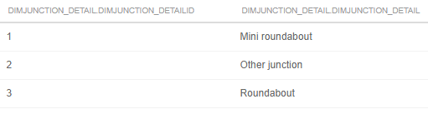
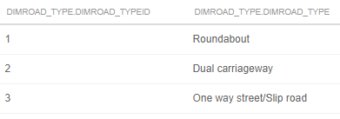
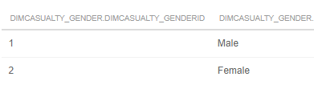





DIMENSION TABLES
DIM DRIVER’S GENDER
DIM CASUALTY AGE
DIM JUNCTION DETAILS
DIM ROAD TYPE
DIM CASUALTY GENDER
DIM TIME
DIM ACCIDENT SEVERITY
DIM WEATHER TYPE
DIM ACCIDENT LOCATION
DIM VEHICLE TYPE

Slide 28



FACT TABLES
FACT 1
FACT 2
FACT 3

Slide 29



FACT TABLES
EVIDENCE OF FACT AND DIM TABLES IN HIVE FROM PUTTY
FACT 4
FACT 5

Slide 30



CONNECTING HIVE TO TABLEAU
Connect hive to tableau via Cloudera Hadoop
FACT tables in tableau
DIM tables in tableau

Slide 31



Linking Primary keys in Dimension Tables to Composite keys in Fact Tables
Linking “LocationID” in DIM table to “LocationID” in FACT table
Linking “Accident severityID” in DIM table to “Accident_severityID” in FACT table

Slide 32




Evidence Of Entity Relationship Diagram In Tableau

Slide 33


Evidence of Data Mart
Why Star Schema?
Star schema is adopted because it supports Kimball methodology which allows us to construct several star schemas to fulfill various reporting needs.
star schema allows queries to run instantaneously because it is made up of small dimensional-table.
It enables fast data retrieval from the data warehouse, as data is segregated into fact tables and dimensions.
It is easier for managers or data operator to comprehend because of its denormalized structure, which simplifies querying.
Business Question 1
Business Question 2

Slide 34



Evidence of Data Mart
Business Question 3
Business Question 5
Business Question 4

Slide 35

Business Quesion1

Slide 36

Business Quesion1

Slide 37

Business Quesion2

Slide 38

Business Quesion3

Slide 39

Business Quesion4

Slide 40

Business Quesion5

Slide 41
Recommendation
We suggest that patrolling units and paramedics should be more active during 7am to 8am in the morning and from 5pm in the evening to help drivers and pedestrians.
The local authorities need to create awareness to drivers to always stay within speed limits particularly when there is poor visibility like bends, brows and in bad weather and avoid overtaking
Local authorities need to provide readable and clear crossroad signals so that vehicle coming from different lanes can see clearly
Older road users should have their driving license renewed every 5 years to reassess their competence and eligibility. Also, ensure they access their regular eye check every year.
The Local Authorities should empower the police to increase enforcement of important road traffic laws to reduce serious injuries and fatalities on the road
The Local Authorities should ensure that there more Road Safety Officers on the road on Fridays and Sunday to make sure road users strictly adhere to stipulated speed limits while hurrying home on weekends
We recommend a monthly television and radio program to educate , and change the attitude of the road user

Slide 42
Future works
we observed that Apache hive does not have the strong capability to extract data from several dimension tables, it takes a lot of time to do so, hence, we suggest that other data warehouse like Azure Synapse Analytics(Azure SQL Data Warehouse) should be considered.
More memory allocation is needed in Azure visual machine to allow the Etraction of big data
The scope of our business questions was limited to the age of victims, we recommend that the gender of this victims should be considers to create awareness to the targeted audience

Slide 43
References
Boarnet, M. G. (1999). Research & Theory Road Infrastructure, Economic Productivity, And The Need For Highway Finance Reform. In Public Works Management & PolicY (Vol. 3, Issue 4).
Cota, M. P., Castro, M. R. G., & Domínguez, J. Á. (2014). Importancia del uso de la visualización en entornos de toma de decisiones empresariales. Iberian Conference on Information Systems and Technologies, CISTI. https://doi.org/10.1109/CISTI.2014.6876973
Global Industry Classification Standard. (2020). GICS ® Global Industry Classification Standard 2 S&P Global Market Intelligence | MSCI Global Industry Classification Standard 3. www.spglobal.com/marketintelligence.
Gopalakrishnan, S. (2012). A Public Health Perspective of Road Traffic Accidents. Journal of Family Medicine and Primary Care, 1(2), 144. https://doi.org/10.4103/2249- 4863.104987
Hadoop: The Definitive Guide - Tom White - Google Books. (n.d.). Retrieved June 10, 2022, from https://books.google.co.uk/books?hl=en&lr=&id=drbI_aro20oC&oi=fnd&pg=PR5&ots=t0BizhlZc6&sig=4Fl_ZLlkoSZpfFDBfthaoAdnp9I&redir_esc=y#v=one page&q&f=false
Hall, C., Kay, R., & Green, J. (2020). A Retrospective Survey of Factors Affecting the Risk of Incidents and Equine Injury During Non-Commercial Transportation by Road in the United Kingdom. Animals 2020, Vol. 10, Page 288, 10(2), 288. https://doi.org/10.3390/ANI10020288
Oussous, A., Benjelloun, F. Z., Ait Lahcen, A., & Belfkih, S. (2018). Big Data technologies: A survey. Journal of King Saud University - Computer and Information Sciences, 30(4), 431–448. https://doi.org/10.1016/J.JKSUCI.2017.06.001
Sarkar, D. (2014). Introducing HDInsight. Pro Microsoft HDInsight, 1–12. https://doi.org/10.1007/978-1-4302-6056-1_1
Link to Data Source
https://weather.visualcrossing.com/VisualCrossingWebServices/rest/services/timeline/south%20Yorkshire/2015-01-01/2017-05-31?unitGroup=metric&include=days&key=WK6LC5WXP2L37SWR96EQ9JVKS&contentType=csv
https://data.gov.uk/dataset/cb7ae6f0-4be6-4935-9277-47e5ce24a11f/road-safety-data
https://roadtraffic.dft.gov.uk/custom-downloads/road-accidents/reports/93e0efc1-6337-44db-ae68-a226eb1c96c0

